Slide 1
i Make Possible!

Slide 2

GLOBAL IMPOSIBILITIES

Slide 3
THEY made it imPOSSIBLE!

Slide 4
Born in a small village in England
“NOT EXCEPTIONAL” in school
Rejected from Oxford University
Mother died of 10 year multiple sclerosis
Had a miscarriage
Husband dragged her out of the house at 5am
Divorced, with a daughter and jobless
Started writing a story when her train was delayed
12 publishing houses rejected her book…
Richest Author in the world
Sold more than 600 million copies
The 13th most powerful women in UK by BBC Radio

Slide 5
J K Rowling
Author : Harry Potter Series

Slide 6
“The truth. It is a beautiful and terrible thing, and must therefore be treated with great caution” J K Rowling

Slide 7
Born to a blacksmith in a small village
Color Blind
Helped his father repair bicycles
Forged signatures on his report cards
Left home at 15
Built a small business for auto parts
TOYOTA rejected his auto parts
Earthquake took away his business
Started a new company at 43
7th largest automobile manufacturer in the world
4 million+ cars produced in factories located across 16 countries
Automobiles, Motorcycles, garden equipment's, Robotics, Jet aircraft, Jet engines etc.

Slide 8
Soichiro Honda
Founder : Honda Motor Company, LTD

Slide 9
“Success represents the 1% of your work which results from the 99% that is called failure.” Soichiro Honda

Slide 10
Parents thought he might be intellectually disabled
Didn’t speak till the age 4 years old.
Many people believed he would not succeed at anything
Played violin at the age of 6
Dropped out of School at the age of 15
No employment skills
He failed the entrance exam several times before getting into institute of Technology…
Took 9 years to get a job in academia
The theory of relativity and more theories
Won the Nobel prize
Awarded fellowships or memberships of all the leading scientific academies throughout the world

Slide 11
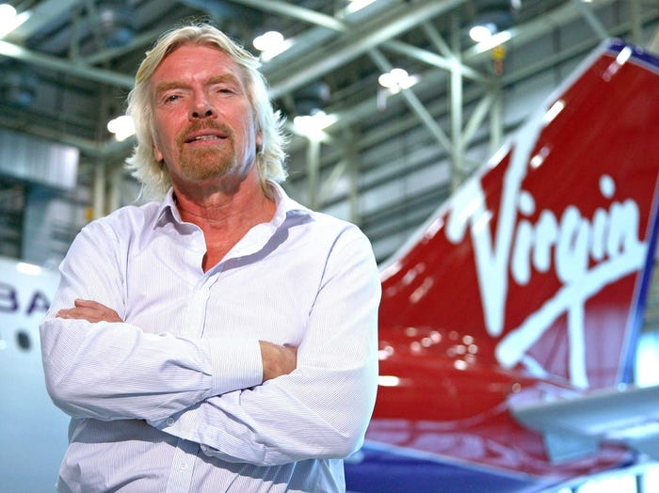
Sir Richard Branson
Founder : Virgin Group

Slide 12
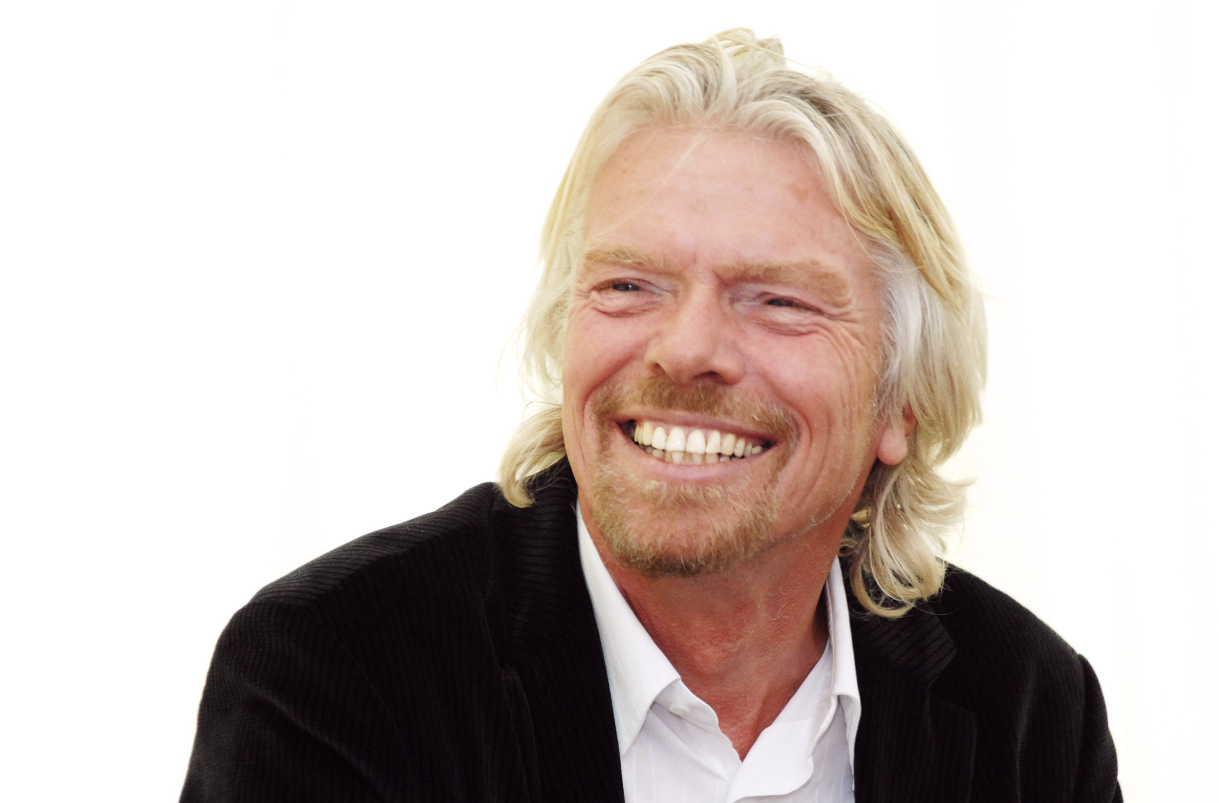
“Do not be embarrassed by your failures, learn from them and start again.” Richard Branson

Slide 13
He was unable to speak fluently till the age of 12 years old.
At school he was nicknamed “pig-dog”
At age 16 he was expelled from the Rotterdam Academy
He went on to pursue life as a musician and a standup comic.
He was busted for stealing from the celebrities he worked with.
He failed the entrance exam several times before getting into New York’s Fashion institute of Technology…
Invented a stationary refrigerator, electromagnetic pump, a self adjusting camera, sound replication device and dozens more
The theory of relatively and more theories
Won the Nobel prize
Notes:
Einstein attended elementary school at the Luitpold Gymnasium in Munich. However, he felt alienated there and struggled with the institution's rigid pedagogical style.
He also had what were considered speech challenges, though he developed a passion for classical music and playing the violin, which would stay with him into his later years. Most significantly, Einstein's youth was marked by deep inquisitiveness and inquiry.
won the Nobel Prize for physics for his explanation of the photoelectric effect

Slide 14
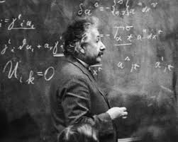
Albert Einstein
Theoretical Physicist

Slide 15
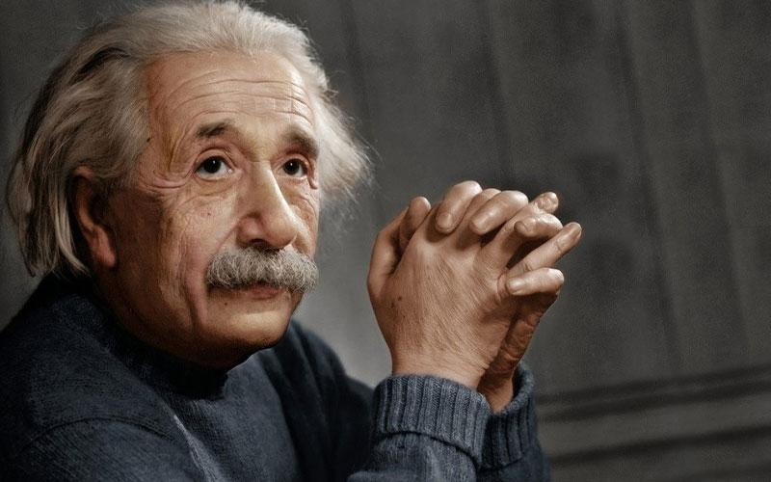
“Try not to become a man of success, but rather try to become a man of value.” Albert Einstein

Slide 16
UAE National
Degree in Business and Marketing from the American University in Dubai
MSC from London Business School
Held several Investment & Technology executive posts
First Arab female to ski across North Pole
Without any motorized equipment – 100 nautical miles
Without any RESUPPLIES or other assistance on ice.
Constantly shifting sea ice
Pulled her own sledge across the frozen Arctic
MINUS 40 degrees Celsius

Slide 17
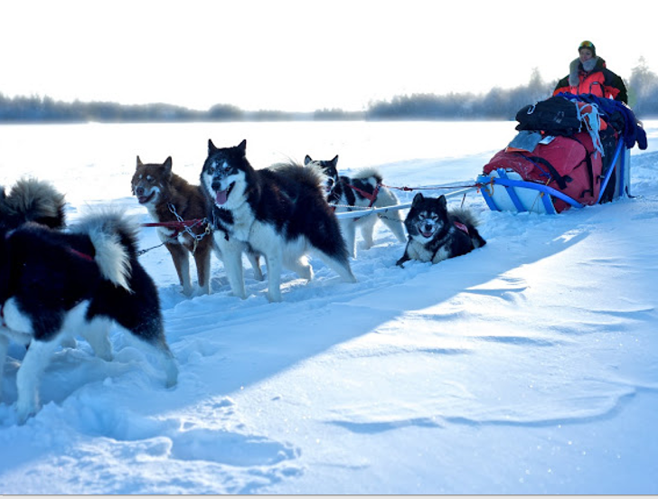
Elham Al Qasimi
Chief Strategy Officer/Entrepreneur/Trekker

Slide 18

“Empowering women in our society is, in fact, not only our collective responsibility, but our national duty.” Elham Al Qasimi

Slide 19
possible.

Slide 20
THE LEADER

Slide 21

1990

Slide 22


Slide 23
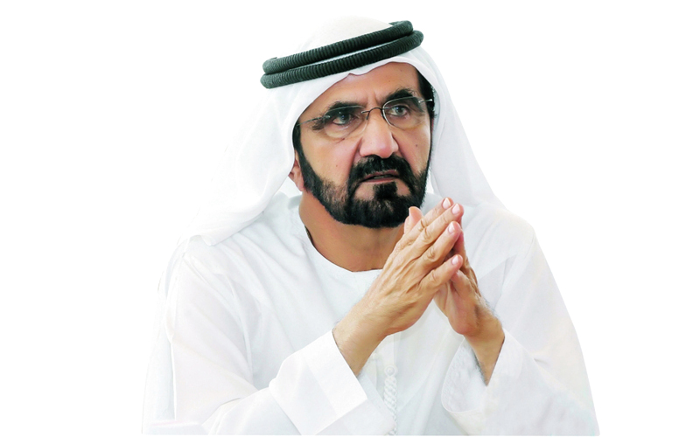
“Impossible is a word used by some people who fear to dream big.”
HH Sheikh Mohammed bin Rashid Al-Maktoum
Notes:
These successes are due to the wise foundations laid down by the leadership of the founding fathers of the country. Their visions have been carried into the present day.
His Highness Sheikh Mohammed bin Rashid Al Maktoum, Vice-President and Prime Minister of the UAE and Ruler of Dubai said “ Impossible…
And We have every right to dream to be among the best countries in the world. Lets look at a short video of his journey and a glimpse of his mindset and vision and how they make it possible.

Slide 24
Notes:
Video

Slide 25
Notes:
The UAE now stands among the most advanced nations in the world. It’s all because they had a vision. They rose to the challenge of building a modern and progressive nation. They turned their vision into reality.
Their leadership firmly believes that development is an ongoing process guided by an innovative vision capable of meeting challenges. “Nothing is impossible for the UAE”

Slide 26

World’s largest flower garden

Slide 27

World’s tallest building

Slide 28

World’s largest synchronized car dance

Slide 29

World’s largest water fountains

Slide 30

World’s largest picture frame building

Slide 31

World’s largest Ferris wheel

Slide 32

World’s deepest pool

Slide 33

1st Middle East Country to reach Mars

Slide 34

1st Middle East Country to host

Slide 35
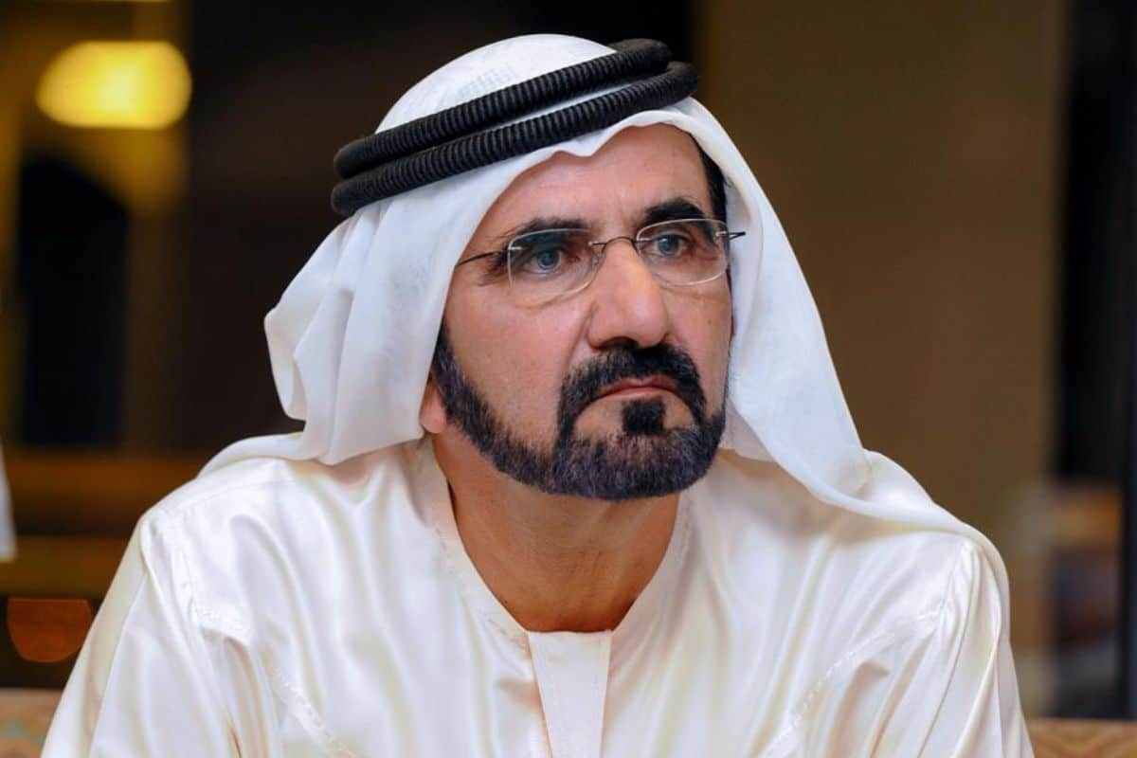
“The future belongs to those who can imagine it, design it, and execute it. It isn't something you await, but rather create.” HH Sheikh Mohammed bin Rashid Al-Maktoum

Slide 36
possible.

Slide 37
THE IMPOSSIBLE CHALLENGE

Slide 38



The Impossible Challenge
Each team must build a rocket ship to protect a raw egg when thrown.
Winning Team Criteria:
The ship travel distance
The egg is not broken
In the case of a tie: Creativity and effectiveness of the design will be considered
Materials:
• 7 straws
• 5 barbecue sticks
• 1 roll of tape
• 1 sheet of flipchart paper

Slide 39
possible.

Slide 40
9 Steps to Making the Impossible Possible

Slide 41

VISION

Slide 42

FAITH/BELIEF

Slide 43

FAIL FORWARD

Slide 44

Handle Fear

Slide 45

Get Rid of Negative People
Notes:
It's been said that one bad apple can spoil the whole bunch and often, that applies to the business environment. It's usually easy to identify that Negative Nancy or Debbie Downer who wreak havoc on morale. Their bad attitudes, catastrophic thinking, and fatalistic outlooks can infiltrate the ranks and spread like an epidemic.
Negative people can also cause problems for us on an individual level. Perhaps it's that vendor who causes you to grit your teeth. Or maybe it's a colleague whom you avoid at all costs. It's important to recognize when these negative individuals intrude in your life in an unwelcome manner.
Sometimes, we unknowingly give toxic individuals influence over our thoughts, behaviors, and feelings. Whether you spend two hours complaining about that boss you don't like, or you let an angry customer ruin your day, it's important to regain your personal power.
Here are five strategies to take back you power and reduce the detrimental impact negative people have in your life:
1. Guard your time
Negative people can monopolize your time - even when they're not with you - if you’re not careful. It's easy to spend two hours dreading a one hour meeting with a negative person. Combine that with two hours of venting to a co-worker after the meeting, and you've just given that person five precious hours of your time.
Don’t allow negative people to steal your time and energy. Rather than complain about people you don't enjoy, choose to strike up conversations about pleasurable topics. Similarly, instead of spending your commute thinking about how much you dislike that person you have to work with, turn on the radio and listen to music that reduces your stress. Take back your power by limiting the amount of time you spend talking about, thinking about, and worrying about unpleasant people.
Negative people should get the least of our time and energy, yet we often give them the most attention.
2. Choose Your Attitude
Spending time with negative people can be the fastest way to ruin a good mood. Their pessimistic outlooks and gloomy attitude can decrease our motivation and change the way we feel. But allowing a negative person to dictate your emotions gives them too much power in your life.
Make a conscious effort to choose your attitude. Create a mantra, such as, “I’m going to stay positive today despite the people around me,” and repeat it often to help you stay on track. Take a deep breath and decide that you're going to make it a great day, despite what others say or do.
3. Refocus Your Thoughts
Negative people often influence what we think about. Perhaps you're so distracted by your colleague's know-it-all attitude that you can't contribute productively to the meeting. Or, rather than think about how to improve your performance, you spend more time thinking about how upset you'll be if that unpleasant co-worker gets a promotion.
Pay attention to how your thoughts change when you're faced with negative people. The more time you spend dreading, fretting, worrying, and rehashing, the less time you'll have to devote to more productive things. Make a conscious effort to reduce the amount of mental energy you expend on negative people.
4. Choose to Behave Productively
Negative people can bring out the worst in us if we're not careful. Sometimes certain pessimists seem to have the power to raise our blood pressure, for one reason or another. A normally calm, mild-mannered person may resort to yelling when he can’t take one more second of negativity. Or, after being surrounded by negative co-workers for hours, an optimist may find herself convincing others that the company's future is doomed.
Although it can be tempting to say, “She makes me so mad,” blaming others for your conduct gives them more power. When you act in a manner that isn’t consistent with your usual behavior, accept responsibility for it. Commit to controlling your emotional reactivity and staying true to your values, despite your circumstances.
5. Seek Out Positive People
It’s difficult to look on the bright side when you’re surrounded by negativity. Seek out positive people to keep you balanced. Just like negative people can rub off on you, a positive person can brighten your spirit.
Identify the positive people in your life. Proactively schedule time with them on a regular basis. A quick lunch with a jovial colleague or a family gathering that’s guaranteed to be filled with laughter can help you stay on track.
Decide that you're not going to allow negative people to determine how you think, feel, and behave. Take back your power and focus your time and energy on becoming your best self.

Slide 46

Invest in Yourself
Notes:
Someones opinion n o you doesn’t have to be a reality
. Develop Your Skills
Improving your skills doesn’t always mean investing in higher education, though that’s surely an option, and perhaps a necessary one depending upon your career field. Investing in your knowledge and skills can take many forms.
In addition, expanding your level of knowledge and skill isn’t limited to the business arena and doesn’t necessarily need to be formal. There are many “skill investment” avenues.
Advance Your Education
Extra classes, advanced degrees, and relevant certifications, are all valuable investments. Take classes, either in person or online. (Lifehack also offers different online courses that help you to break free from your limits.)
If you’re interested in getting ahead in your career, this may be a great place to start to invest in yourself as extra skills will open more doors. Set goals around your education and start investing time in research.
Utilize Available Training
Enroll in workshops, attend conferences, or participate in webinars. Many of these are free for participants, so take advantage of them as often as possible.
Expand Your Knowledge
There’s a lot of information available on nearly any subject imaginable. To invest in yourself, read books, peruse articles, watch TED talks or YouTube videos…anything related to the talent or skill you want to work on.
Keep Current
Stay up-to-date on the latest trends or advancements. Subscribe to publications, read blogs of experts, and follow the latest news.
2. Explore Your Creative Side
There is a fountain of creativity within most of us that has never been tapped or certainly hasn’t been used to its highest potential. We may need to unearth and hone our individual creativity by learning a new skill or spending time on something that brings us joy.
Creativity in any form helps us to grow personally and professionally, to view problems and solutions in different ways, and to utilize other parts of our mind that may have been previously untapped^{[1]}. It’s important to keep in mind that creativity has many faces. It’s far broader than being a painter or sculptor; it’s also about trying new things.
Learn a new language: Take a class or use language training software.
Try gourmet cooking: Enroll in a formal class, by a new cookbook, or ask someone you know who enjoys cooking in a different way.
Write something: A book, short stories, poetry, anything.
Explore the outside world: Try gardening, bird watching, or landscape photography.
Enjoy music: Play an instrument, learn a new one, or join a music group of some kind.
Create something tangible: Paint, sculpt, make pottery, make jewelry, or design your own clothes.
Choose some form of activity that you have never tried, haven’t practiced in years, or have never explored fully.
3. Nurture Your Mind and Body
Nurturing both your mind and body allows you to have more to give now and in the future—more energy, knowledge, compassion, ideas, strength, and physical and mental endurance.

Slide 47

NEVER QUIT!
Notes:
No matter how hard it gets, how difficult it is.. Don’t stop.
You may be the only person left who believes in you, but it’s enough. It takes just one star to pierce a universe of darkness. Never give up. ~Richelle E. Goodrich
We feel like giving up, at some point in our lives, in the various journeys that we undertake. Sometimes we give up even before we start. And at other times, most crucially, we tend to give up just before we are about to make a huge break-through.
But we should realize that our hardest times often lead us to the greatest moments of our lives. ‘Keep going’ should be our mantra. Tough situations build strong people in the end. We should not fear failure but rather fear not trying.
Anything is possible. As long as you are alive, healthy and free, you have the choice to keep trying until you finally succeed. But yes you have to be realistic.
The words “give” and “up” should never be together. And particularly, the word ‘No’ shouldn’t even be in your vocabulary. Being part of the human kind you are one of the most enthusiastic and strongest beings to have ever walked on the earth.
You probably, don’t even realize that there are a countless number of positives inside of you. And every now and then when you lose motivation, a quick reminder of what your potential is can really help. To taste success, you are always faced with temporary defeat, just always keep in mind.
If you give up at these defeats you will fail, but if you keep going you will become successful.
Here are some of the reasons why you should never give up:
You have everything you need
You are alive and for you nothing is impossible
You need to prove it to yourself
Success feels great
It could change for the better
This is meant to happen, you were destined to do this
You will learn a lot from not giving up
You deserve happiness and success
Failure is normal
It’s always the darkest before dawn
Says Jack Ma, Never give up. Today is hard, tomorrow will be worse, but the day after tomorrow will be sunshine.
So stay true to yourself, yet always be open to learn. Work hard, and never give up on your dreams, even when nobody else believes they can come true but you. These are not cliches but real tools you need, no matter what you do in life to stay focused on your path.
What Is Achievement?
When we think of an achievement, we tend to picture something out of the ordinary, like exceeding targets, landing a big sale, or delivering a project milestone.
But other, less measurable, behaviors deserve recognition, too – for example, pulling together as a team to head off a crisis, learning and applying a new skill, or supporting new recruits. Even something as simple as quietly consistent good work can be worthy of celebration.
You might wonder why you should bother to bolster your team members' self-esteem in the first place. After all, aren't they just doing what they're paid for?

Slide 48

It’s Not Over…

Slide 49

CELEBRATE

Slide 50



Slide 51
MOTIVATION

Slide 53
possible.

Slide 54
YOU CAN NOW TAKE A BLANK PIECE OF PAPER
THIS IS AN “I MAKE POSSIBLE”
MEMORY

Slide 55
TAKE 5 MINS AND WRITE YOUR DREAM ON IT
ANY DREAM
THIS PAPER WITH GO WITH YOU
AND REMIND YOU EVERYDAY
WHAT YOUR DREAM IS
AND WHAT YOU NEED TO MAKE…
possible
Notes:
1. ANY DREAM!

Slide 56
THANK YOU!
Vision without action is merely a dream. Action without vision just passes the time. Vision with action can change the world. —Joel A. Barker
Notes:
With that I thank you very much for attending this session and for your participation. I really enjoyed this session and I look forward to your feedback on the survey that will be sent to you. And I hope this session has inspired you to follow your passion. You don’t have to be the next Einstein but be the best you can be! Rise up and become the person you would be proud of.
Wishing you all the best and have a great day!

Slide 57
i Make Possible!

